Slide 1
Workshop: Reaccreditation- A way forward towards continuous improvement
Consultants:
Dr. Kamran Ali Chatha Dr. Hamid Hassan
LUMS FAST School of Management

Slide 2
Summary
NBEAC Overview
Process flow chart for Accreditation
NBEAC Re-accreditation Process
Key Challenges for Re-accreditation (Discussion)
Notes:
Add Animation

Slide 3
NBEAC: An Overview
What is NBEAC?
Nationally and Internationally recognized body for Higher Education Accreditation of Business Degree Programs
Accreditation through NBEAC will mark the highest standard in business education in Pakistan.
When was NBEAC Established?
NBEAC was Established by Higher Education Commission (HEC) in March, 2007.
How will NBEAC facilitate Business Schools?
Through Accreditation process
Through mentoring process i.e. Pre Eligibility Mentorship (before datasheet submission) and Pre Review Mentorship (before SAR submission)
Notes:
Add Animation

Slide 4
NBEAC: An Overview contd…
Purpose
NBEAC will facilitate and enhance the quality of business education in the country through certain minimum standards.
Strategic Management
Curriculum
Students
Faculty
Research and Development
Social Responsibilities
Resources
Academic & Corporate Linkages
Admission Policy
Notes:
Add Animation

Slide 5
NBEAC: An Overview contd…
Vision Statement
“Enhancing the Quality of Business Education”
Mission Statement
Ensure member institutions surpass the minimum threshold requirements of accreditation of a business or business related degree program;
Provide training and support for enhancing the quality of accredited degree programs and employment prospects of graduates; and
Build capacity for the faculty, staff and administrative support of member institutions.
To ensure that all management development institutions are embarked on a journey to continuously enhance quality of their people, processes, research and programs.
To serve as a platform for mutual sharing of experiences that contribute towards enhancing the quality of management education and industry practices in the country.

Slide 6
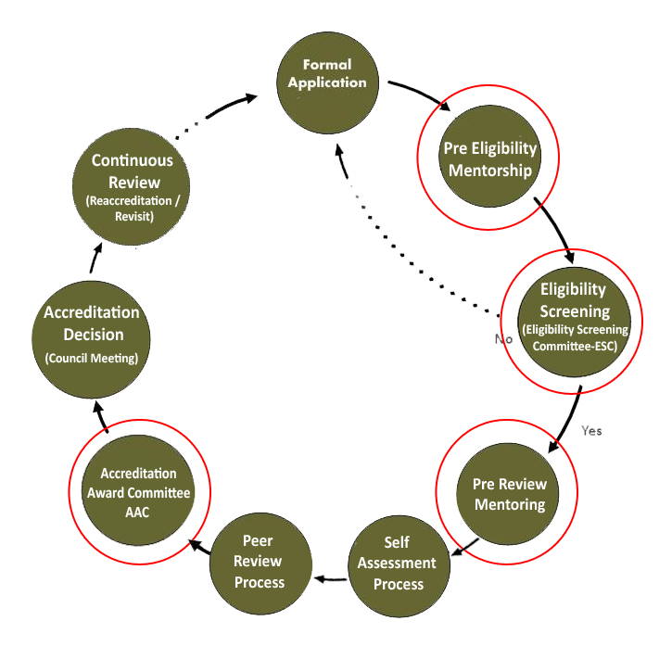
Process Flow for Accreditation
Optional
Optional
CIR is ”critical” in re-accreditation

Slide 7
NBEAC Re-Accreditation Process
The Business Schools with their programs accredited for a period of 5 years and 3 years shall have to enter into the re-accreditation process about six months before expiry of the accreditation period if they want to maintain accreditation of their programs.
The re-accreditation process involves all steps of first time accreditation including registration process.

Slide 8
NBEAC Re-Accreditation Process contd…
The University shall fill the registration application and submit to NBEAC one month before the schedule of Eligibility Screening Committee meeting (displayed on NBEAC Website).
The ESC shall review the registration application as per basic eligibility screening criteria.
Program started date: At least 3 batches of the degree should have passed to consider the program for accreditation.
Mission and Vision Statement
Strategic plan
Faculty- minimum of 15 full time faculty members related to Management Sciences/ Business Administration field. 03 faculty members at Prof/ Associate Prof level are preferable however, minimum 02 Associate Professors and 03 at Assistant Professors are required to become eligible for accreditation process.
Bandwidth Internet service (desirable) = 1 MB access rate
Student to Computer ratio: 1:20

Slide 9
NBEAC Re-Accreditation Process contd…
The decision of committee is communicated by NBEAC Secretariat to Business Schools through Initial Eligibility Screening (IES) letter.
Not Qualified -> Pre Eligibility Mentorship
Qualified-> Self Assessment Process
Self Assessment Process
Pre Review Mentoring i.e. Mentor Visit
Self Assessment Report
Continuous Improvement Report (CIR)
Desk Review Report by NBEAC Secretariat

Slide 10
NBEAC Re-Accreditation Process contd…
The programs applying for re-accreditation are subject to the same fees and same NBEAC Standards as the programs undergoing first-time accreditation.
The peer review visit duration and composition of the Peer Review Team(PRT) shall also remain intact. However, the PRT leader who led the team during the previous accreditation process of the program cannot be retained as part of team appointed for peer review visit in connection with re-accreditation of that program. However, one of the members of that team can be included into the re-accreditation PRT.

Slide 11
NBEAC Re-Accreditation Process contd…
The Council shall make the decision on the re-accreditation of the program based on the report and recommendations of the PRT and re-accredit the program for 5 years and 3 years duration.
There will be four types of accreditation decisions
05 years, W=80% and above
03 years, X=65%- 79% ( 65% will be raised to 70% from the year 2020 onwards)
Not qualified for accreditation =Less than 65%
The option will be provided to the school for “accreditation withdrawal “from the accreditation process after a negative recommendation by the peer review team.

Slide 12
Discussion KEY CHALLENGES FOR REACCREDITATION AND SOLUTION STRATEGIES

Slide 13
Re-Accreditation Project
Challenges | Solution Strategies
Importance of PRT report Not able to analyze the previous PRT. | Need to believe that PRT report is an important document for next accreditation process. Need to carefully scan the previous PRT report and develop objective recommendations in hierarchical order well before (ideally soon after the receipt of PRT report) the reaccreditation starts. Scanning of PRT should involve Dean/HoD and Project team including senior faculty members. Better to include new members in the previous team to rule out defensive behavior and bring criticality of self assessment. New Project team to define timelines to achieve required millstones and mechanism to share the progress with the HoD and Dean on regular basis.

Slide 14
Re-Accreditation Project
Challenges | Solution Strategies
How to read PRT report | Link between Units and layers VS coherent structure Spillover effect Policy /Practice / Impact / Impact measurement mechanism / possibility of corrective action Consistency and documentation Objective requirements of improvements mentioned in PRT and workable for Business School should be shared with all stakeholders and faculty members.

Slide 15
Re-Accreditation Project
Challenges | Solution Strategies
Not able to objectively work on PRT report Self serving biasness /low self criticality approach while monitoring the progress | Develop project team with reasonable number of new members and allocate targets with objective measures as per scanning of PRT report. Share the objective requirements/required resources with the top management . Objective outputs should be presented in a meeting with HoD/Dean involved. Use benchmarks from accredited business schools around and continuously remain in touch with the developments at NBEAC secretariat. Separate the execution of plan and the process of assessment of progress. Monitor the timeline. Enter in the reaccreditation process only after the objective, measurable and presentable improvements in the high priority areas mentioned in the PRT report.

Slide 16
Re-Accreditation Project
Challenges | Solution Strategies
Not able to properly prepare and present CIR | Need to believe that CIR is the second important document for reaccreditation process. Make CIR as a comparative two column document with previous and current conditions. Don’t forget to Present progresses Other than previous PRT recommendations at the end of CIR. Reveal CIR as the first presentation in front of Reaccreditation PRT. If possible a summary of CIR relevant to a session should be briefed before every session of Reaccreditation PRT.

Slide 17
Re-Accreditation Project
Challenges | Solution Strategies
SAR as edited version of previous SAR document Self Assessment | SAR should be prepared as a new document rather than edited version of previous SAR. New team members can play key role in making it happen. CIR and reaccreditation SAR should complement each other in objective as well as subjective way. Strategic Plan should be able to exhibit on going march towards set objectives during the previously awarded accreditation period Better to conduct a brief in house Self Assessment activity before the actual visit of Reaccreditation PRT

Slide 18
Re-Accreditation Project
Challenges | Solution Strategies
Managing Reaccreditation PRT visit | CIR VS Relevance of Strategic Plan/Program goals /LOS Before the visit while working on SAR focus on Coherence of areas During the team visit, Focus on the session being conducted By assign a member to each form, Prepare team to produce documents and Follow up & feedback.

Slide 19
Proformae 1: Strategic Management
Challenges | Solution Strategies
Strategy and strategic plan of the school not well defined | Align school’s strategy with vision and mission of the institution. Involve or take input from various stakeholders to develop a shared and coherent strategy. The school should identify key themes, goals, or objectives that make it distinct from other schools in the region. These themes should permeate into various academic programmes. A well-crafted plan including financial and human resources as to how the school is going to meet these themes, goals, or objectives.
Weak or no external participation in academic governance | Industry participation need to be ensured in statutory bodies such as BoG, BoS etc. The advisory board should be comprising of academics from within and outside the country, and industry representatives to ensure rigorous and relevant best practices in school’s governance.

Slide 20
Proformae 1: Strategic Management
Challenges | Solution Strategies
Weak financial stability of the school | The financial resources should commensurate with strategic plan of the school. Profit / loss statement, balance sheet, various sources of income, all provide a fair idea of the financial stability of the school. The schools should explore various sources of funding to complement tuition fees, such as: Consulting Industry trainings Sponsored research Joint research with industry Donations Etc.
Lack of shared governance system | The school should pursue developing standing committees of faculty to ensure faculty participation in school’s governance. The standing committees may be formed around programmes, subject area groups, centers etc.

Slide 21
Proformae 2: Curriculum
Challenges | Solution Strategies
Weak or no academic programme level strategic objectives | Each academic programme should have a strategy distinct from the similar programmes in the region, driven by the role the graduates are going to play in the industry.
Weak or no distinction among MBA / EMBA / UG programmes | The curriculum design should be driven by the philosophy and objectives of a programme and should be significantly different in terms of content, pedagogical methods, as well as theoretical or practice orientation.
Weak or no external participation in the programme design | Industry representatives should be involved in: Strategic review of the programme every 5 years or so; Annual feedback on student quality leading to changes in the programme / course design; Introducing new elective courses; Meeting with programme directors and subject area heads for feedback and introducing new courses; Guest speakers; % of courses to be taught by industry personnel

Slide 22
Proformae 2: Curriculum
Challenges | Solution Strategies
Lack of indigenous teaching material | Teaching material relevant to Pakistan or emerging markets should be made part of every course. The faculty should be involved in developing teaching material for their courses.
Rigorous and relevance of teaching content | In the MBA programme, the teaching content should be comprising more of case studies, industry projects, and experiential learning projects. In the UG programme, the teaching content should be inclined towards understanding theory, rigorous mathematical analysis, and learning of software tools and techniques. There can be some case studies and industry projects.
Grading instruments and policies | The grading instruments and policies in each programme (MBA and UG) must be different and aligned with programme learning objectives.

Slide 23
Proformae 3: Students
Challenges | Solution Strategies
Admissions criteria | The admissions criteria and thresholds should be aligned with strategic objectives of each programme.
Lack of holistic education | School should provide holistic education to students, including curricular, extra-curricular, practical, and experiential learning.
Large Class sizes | Generally it is found that student-to-faculty ratio is one of the weakest areas. Business schools should involve ample qualified faculty to improve this ratio.
Limited alumni involvement | Alumni involvement is often kept limited to extra-curricular activities, though there are significant opportunities for involving them in curriculum delivery, guest speakers in the classes, new course design, and indigenous teaching material development.

Slide 24
Proformae 4: Faculty
Challenges | Solution Strategies
Lack of qualified and research active faculty | Strategies for attracting and retaining qualified and research active faculty members should be employed. These may include: Better pay structures, research environment and incentives Consulting and industry training opportunities Clear career paths for different qualifications and skillsets Faculty recruitment and development plans should be in place
Lack of faculty involvement in decision making | Faculty involvement in decision making can be ensured by instituting various types of committees e.g. programme committees, functional department committees, teaching committee, research committee, teaching committee etc. for the purpose of making recommendations
High workload | 4 courses in a semester coupled with administrative and publication requirements are the norms. Following steps can be taken to rationalize workload by giving teaching reliefs for: Relief for research output Relief for various forms of administrative work and institutional service Setting-in relief for new faculty Etc.

Slide 25
Proformae 4: Faculty
Challenges | Solution Strategies
Practically no involvement in consulting | Shortage of time available to faculty and lack of policy, process, and support systems are major factors that inhibit faculty consulting Faculty should be trained in providing consulting
Lack of involvement in imparting industry trainings | Shortage of time available to faculty and lack of policy, process, and support systems are major factors that inhibit faculty involvement in designing and offering industry trainings Faculty should be trained to design and offer programmes for industry executives
Lack of practical exposure to faculty | Industry visits, industry placement during summer; Mandatory development of cases and other teaching material. Use working industry professionals as adjuncts.
Lack of transparency in faculty appraisal | A transparent and equitable system for faculty appraisal comprising of 360 degree feedback should be in place.

Slide 26
Proformae 5: Research and Development
Challenges | Solution Strategies
Lack of a research strategy / plan | Schools usually do not have a clear research policy. Even the term “research” is used interchangeably with “consulting project”. No clear definition of research thus keeps schools’ efforts haphazard without a focus or direction. Decide what type of research “basic / theoretical” and/or “applied” is more aligned with school’s strategy. Similarly, the place of teaching material development, student projects, industry reports etc. need to be decided upon. A detailed research strategy and plan consisting of strategic objectives, choices, plan and resource needs need to be developed.
Lack of qualified and research active faculty | Enhance faculty research capacity by organizing research workshops on the followings: Research methods Research methodology Research seminars Brown bag series Give incentives for collaborative research between experienced and novice researchers.

Slide 27
Proformae 5: Research and Development
Challenges | Solution Strategies
Lack of time for research | Provide relief for producing research output.
Lack of funds for research | Funds available to R&D and research output should be aligned with research strategy. Seek research proposals from faculty and grant funds to successful proposals for conducting research.
Special interest groups of research | Special interest groups comprising of faculty members who have research interests in same subject area or industry can be formed to encourage collaborative research.
Linking R&D output with student learning | Ways and means need to be explored for taking research output to classroom for student learning.

Slide 28
Proformae 6: Social Responsibility
Challenges | Solution Strategies
Lack of strategy to engage with social sector | Develop a coherent strategy of how the school should engage with social sector and in what capacity. This should include: type of specializations (industries) and activities to engage in given the geographical context of the school. As examples, the schools can engage in: Social sector specific research and development activities Student projects, free consulting and trainings for capacity development Annual social development campaigns Mandatory courses in degree programmes
Support for internal employees | The schools need to institute systems to support internal employees and monitor their satisfaction levels.

Slide 29
Proformae 7: Resources
Challenges | Solution Strategies
Insufficient computer lab and library resources | There are stipulated requirements for the sufficiency of such resources in the NBEAC standards that need to be met. Besides, the quality of these resources should be kept up to the mark.
Proformae 8: Student placement and external linkages
Challenges | Solution Strategies
Lack of national and international academic linkages | First national and then international linkages can be developed for various purposes such as academics (student exchange, guest speakers, student competitions etc.), research (joint research and publications), training and development.

Slide 30
THANK YOU

